Slide 1
FINAL PROJECT EVALUATION
Fake Review Classification and Topic Modeling
- DINESH M

Slide 2
Brief Overview of the Project
This project aims to analyze online reviews to detect fake reviews and extract meaningful patterns using a combination of machine learning techniques.
It involves preprocessing text data, extracting features, and applying clustering and classification algorithms to uncover insights and improve the reliability of online reviews.

Slide 3
Text Preprocessing
Tokenization
Stop word removal
Lemmatization
Feature extraction using TF-IDF for numerical representation

Slide 4
CLUSTERING
K-means
Inertia
Silhouette Score
Elbow Method for optimal K
DBSCAN (Density-Based Spatial Clustering of Applications with Noise)
Epsilon
Min Samples
Noise
Silhouette Score

Slide 5
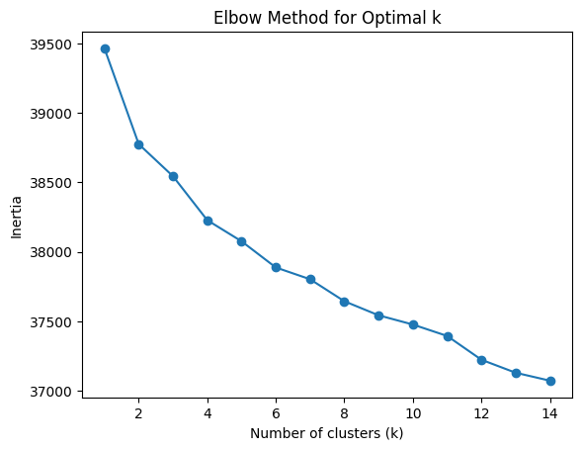
CLUSTERING

Slide 6
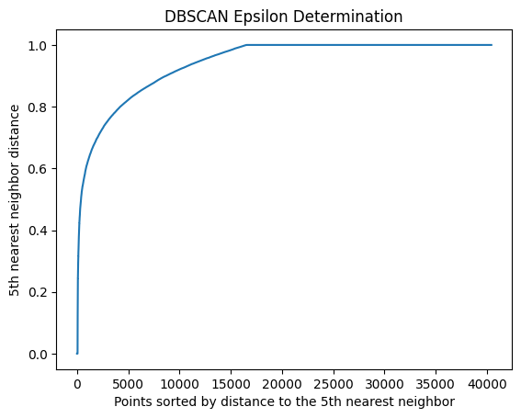
CLUSTERING

Slide 7
CLUSTERING

Slide 8
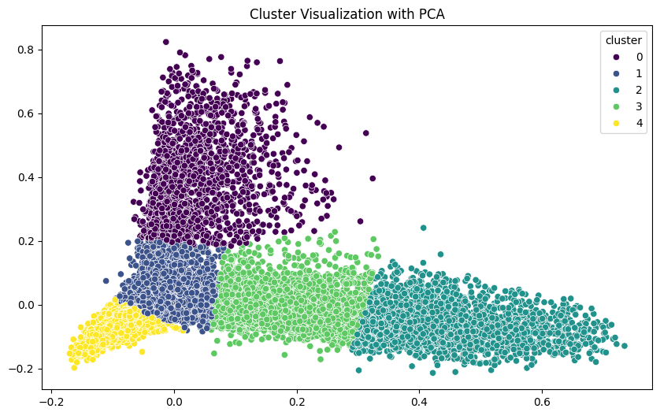
CLUSTERING

Slide 9
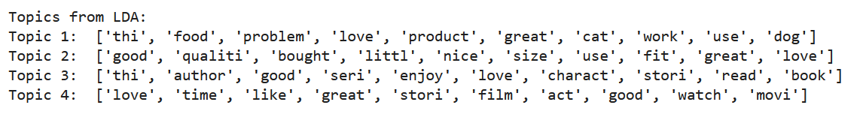
Topic Modelling
Topic Modeling is an unsupervised machine learning technique used to identify hidden semantic structures or topics within a collection of documents. It helps to extract themes or topics from text data, making it easier to understand large text corpora.

Slide 10
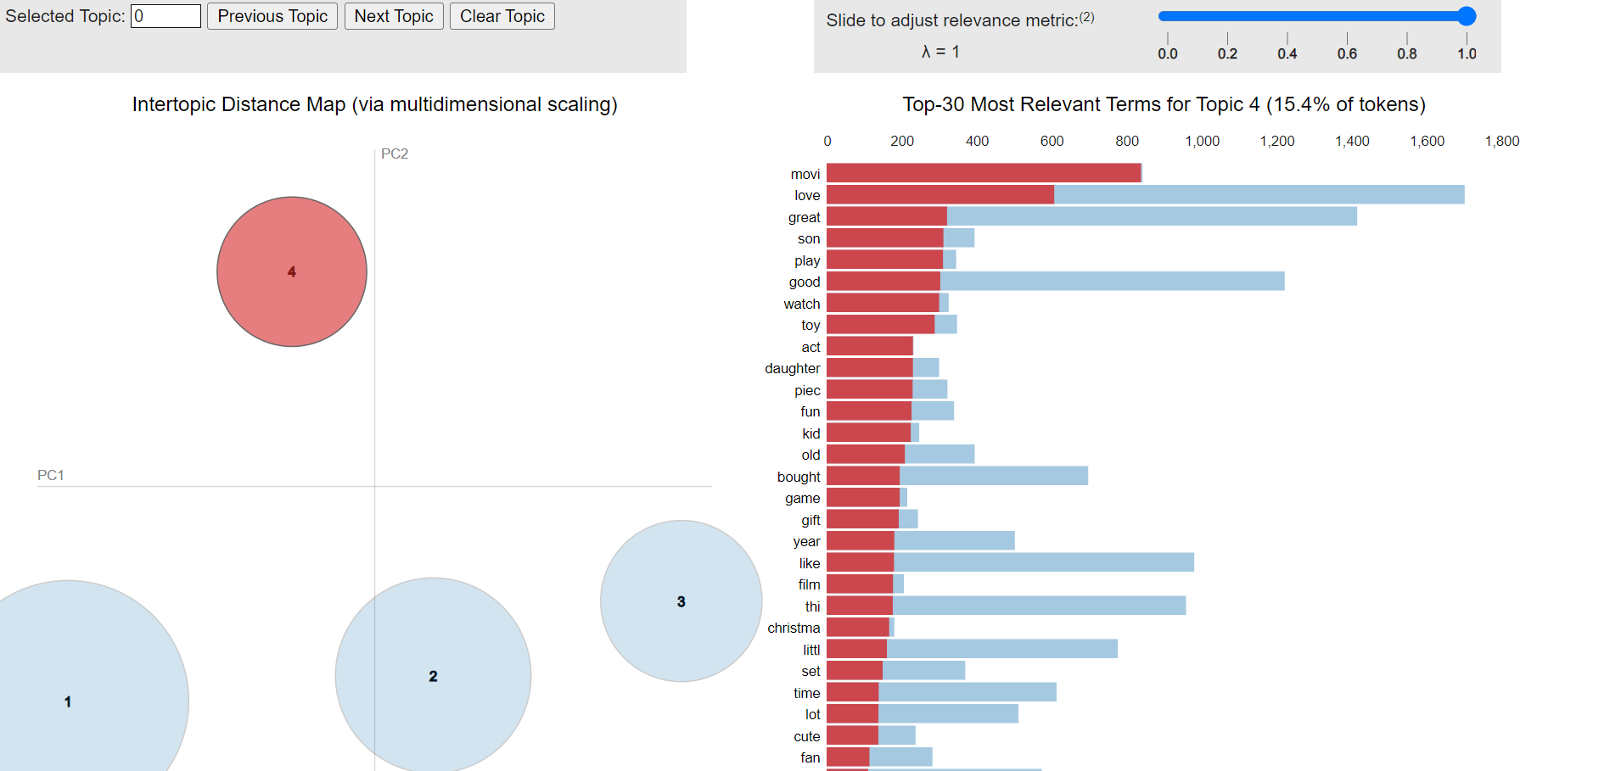
Topic Modelling

Slide 11
Classification
Logistic Regression
Support Vector Machines (SVM)
RoBERTa
Deep Learning Models:
LSTMs

Slide 12
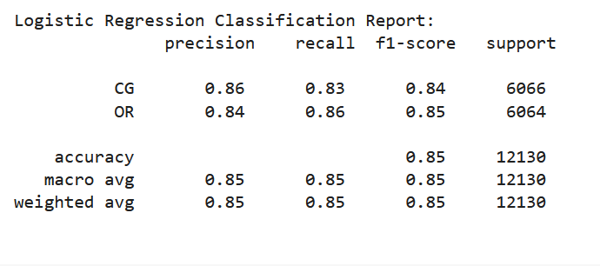
Classification
Logistic Regression is a statistical model used for binary classification tasks. It predicts the probability of a categorical dependent variable based on one or more independent variables. It uses the logistic function to model the data and outputs values between 0 and 1.

Slide 13
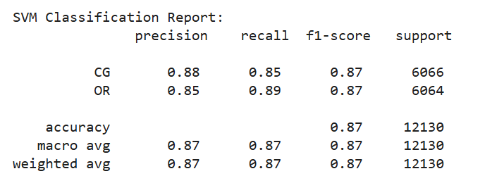
Classification
Support Vector Machine (SVM) is a supervised machine learning algorithm used for classification and regression tasks. It works by finding the optimal hyperplane that best separates data points of different classes in the feature space.

Slide 14
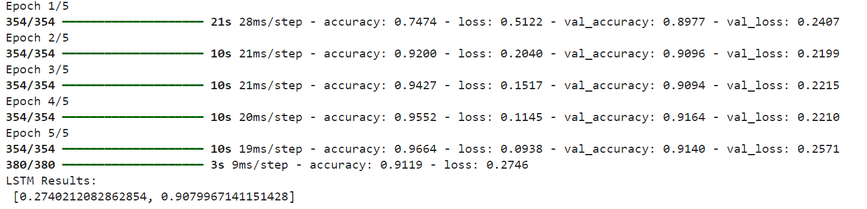
Classification
Long Short-Term Memory (LSTM) is a type of recurrent neural network (RNN) designed to model sequential data. It is effective for tasks that involve long-term dependencies, like time series forecasting and natural language processing, by maintaining information in memory over time.

Slide 15
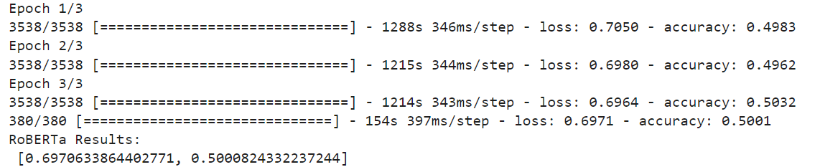
Classification
RoBERTa (Robustly optimized BERT approach) is an advanced version of the BERT (Bidirectional Encoder Representations from Transformers) model. It is pre-trained on large datasets and fine-tuned for specific tasks like text classification, sentiment analysis, and question answering, offering improved performance over BERT.

Slide 16
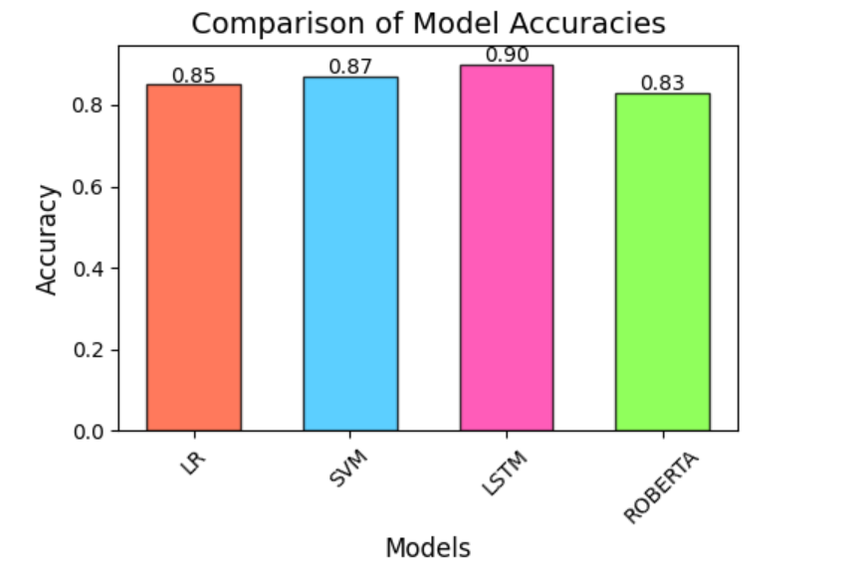
Classification

Slide 17
THANK YOU

